Slide 1


Slide 2
The Issue with Current Voting Systems
Voter impersonation
Fake or duplicate votes
Lack of transparency

Slide 3
Our Solution: Biometric Voting with OTP Verification
Authenticate voters using fingerprint or facial recognition
SMS confirmation for secure, traceable voting

Slide 4
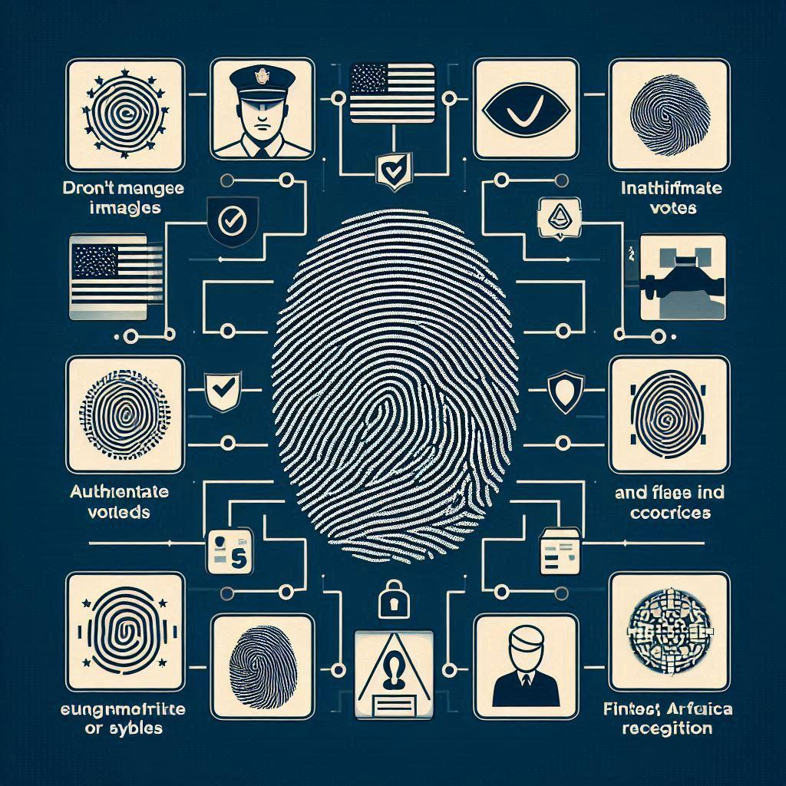
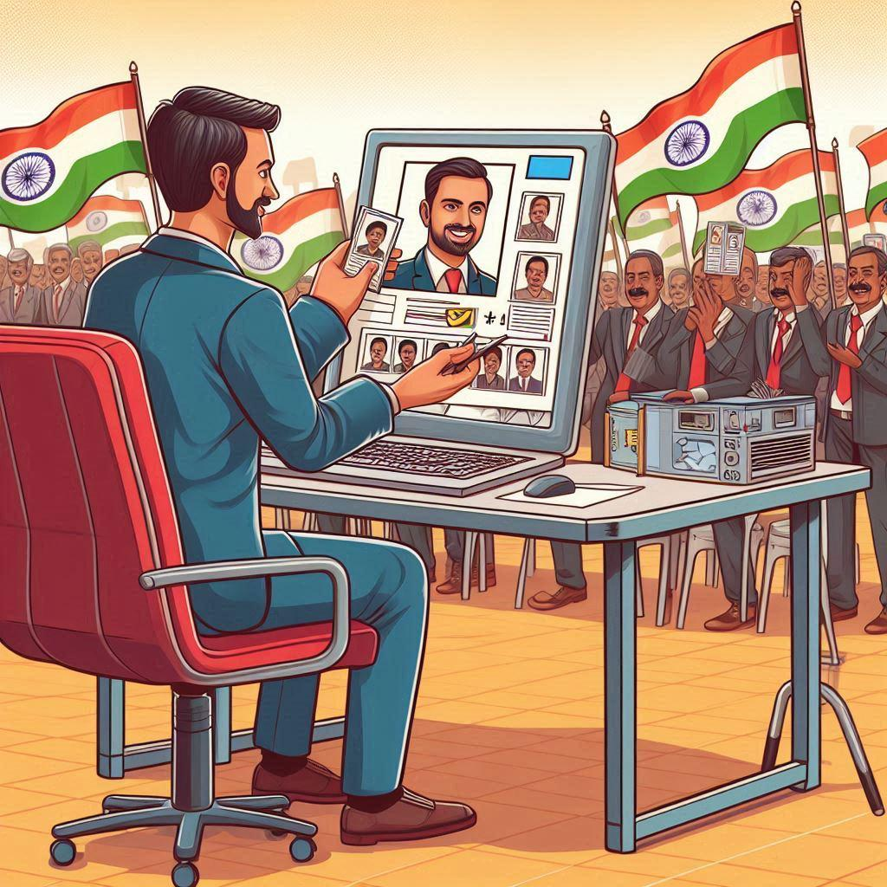
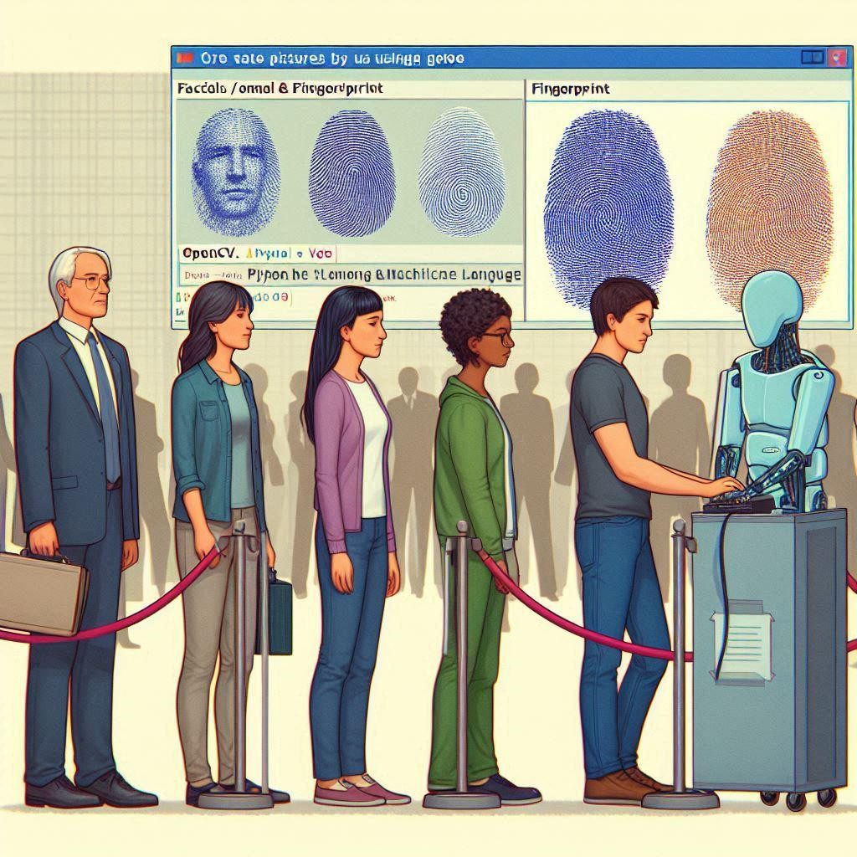
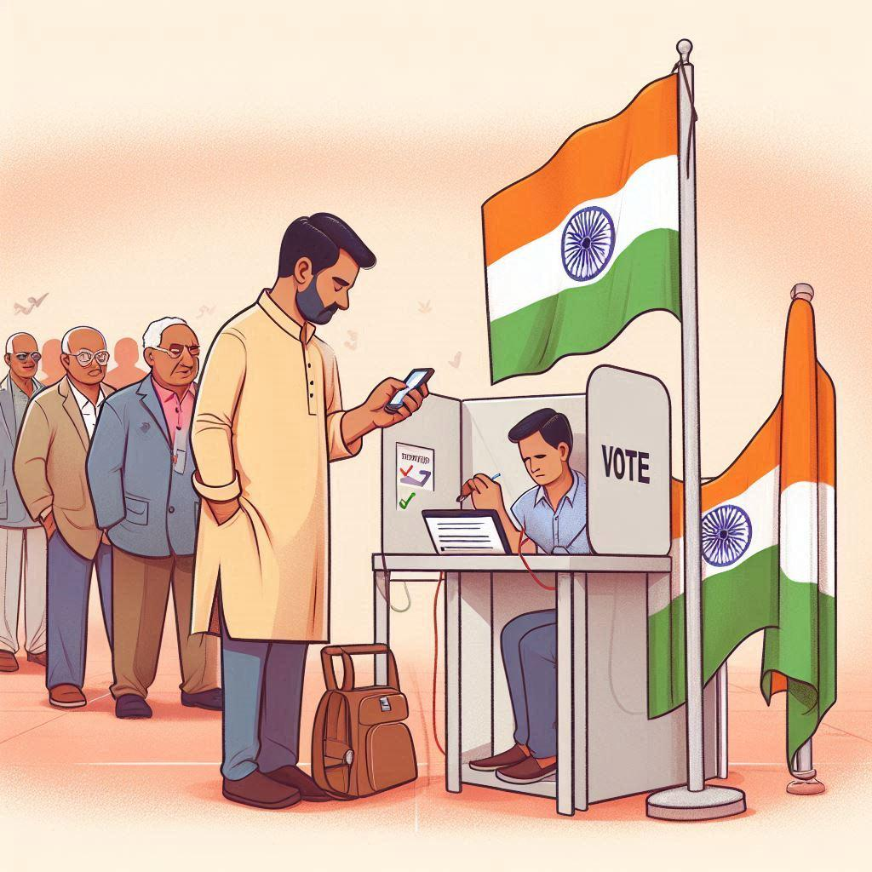
System Workflow
1
2
Biometric authentication
Identity verification
Vote casting
SMS confirmation
3
4

Slide 5
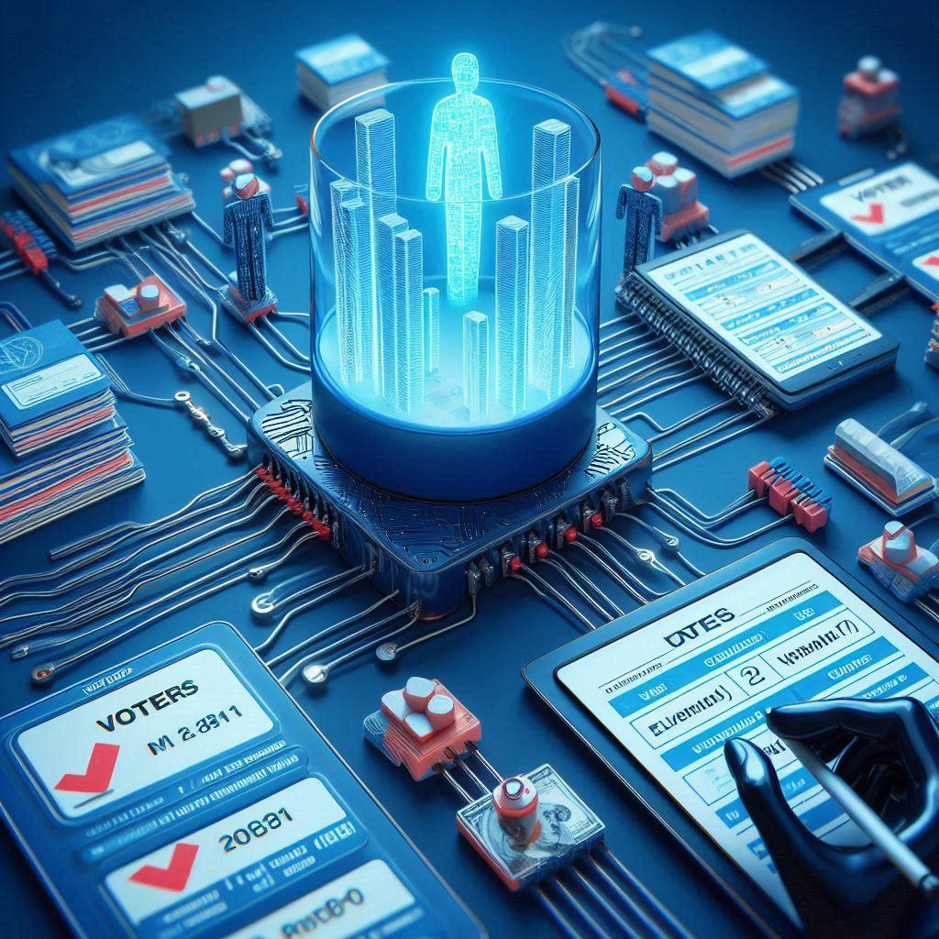



Technologies Used
OTP Generation: Twilio
Database: MySQL/PostgreSQL
Security: Blockchain, Encryption
Facial/Fingerprint Recognition: OpenCV.
Face_recognition(PYTHON &ML)

Slide 6

Why Our Solution is Effective
Eliminates voter fraud
Provides real-time confirmation via OTP
Ensures secure vote storage
Enhances transparency and trust

Slide 7
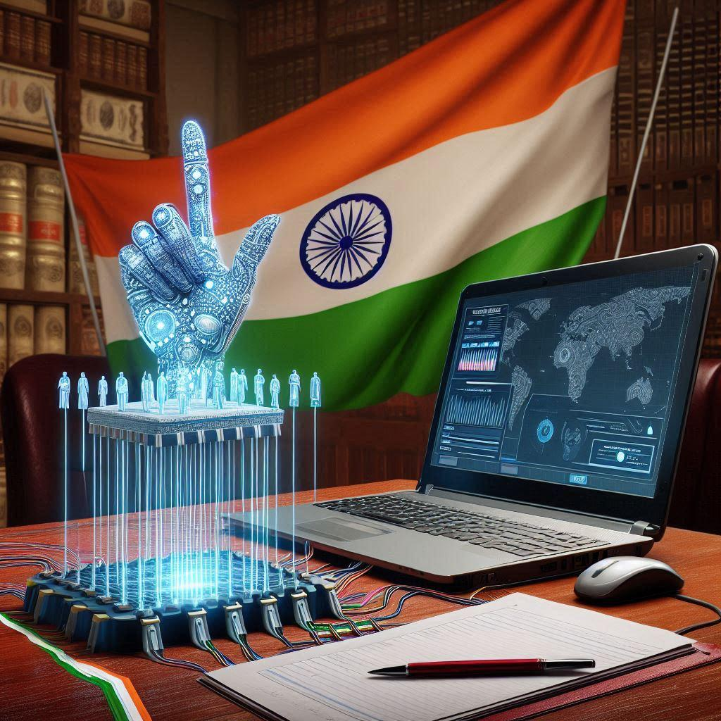
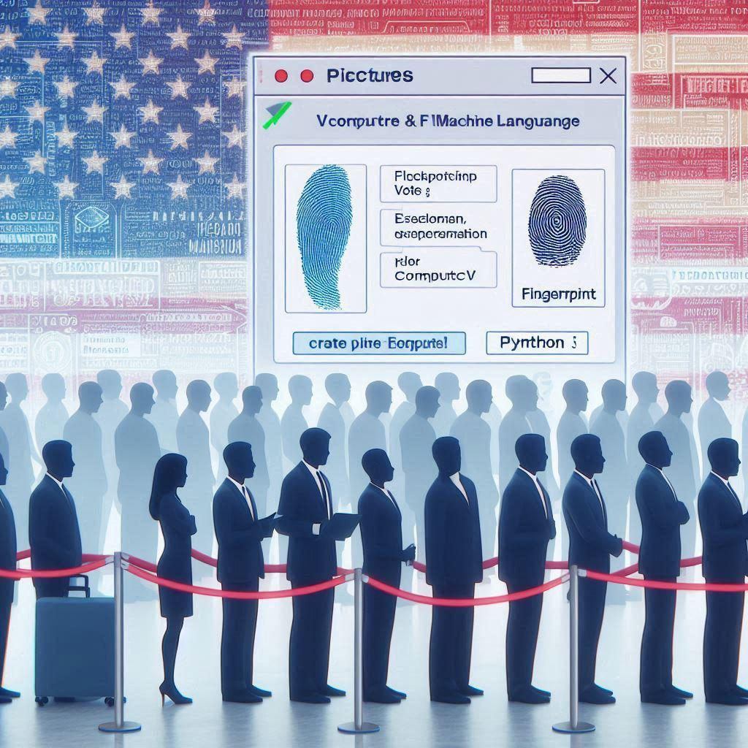
Use Case: Voting Day
Arrive at polling station
Scan fingerprint/face
Cast vote
Receive OTP confirmation

Slide 8


